Slide 2
Objectives Overview
Differentiate among laptops, tablets, desktops, and servers
Describe the purpose and uses of smartphones, digital cameras, portable and digital media players, e-book readers, wearable devices, and game devices
Explain the purpose of a browser, a search engine, and an online social network
Differentiate the web from the Internet, and describe the relationship among the web, webpages, websites, and web servers
Briefly explain various input options
Describe the relationship between data and information
See Page 2
for Detailed Objectives

Slide 3
Objectives Overview
Briefly describe digital security risks associated with viruses and other malware, privacy, your health, and the environment
Differentiate between an operating system and applications
Differentiate between wired and wireless technologies, and identify reasons individuals and businesses use networks
Discuss how society uses technology in education, government, finance, retail, entertainment, health care, science, travel, publishing, and manufacturing
Identify technology used by home users, small/home office users, mobile users, power users, and enterprise users
See Page 2
for Detailed Objectives

Slide 4
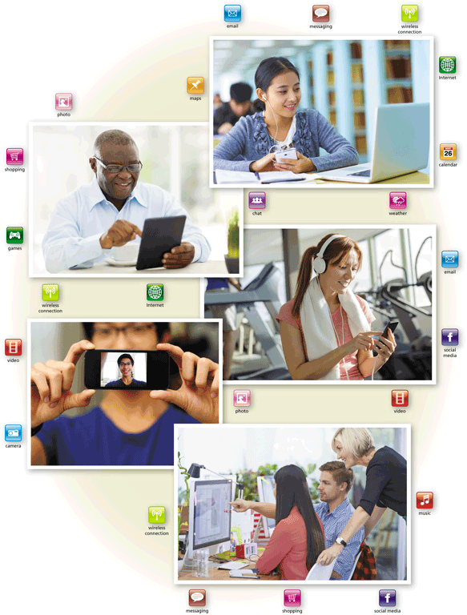
Today’s Technology
Because technology changes, you must keep up with the changes to remain digitally literate
Digital literacy involves having a current knowledge and understanding of computers, mobile devices, the web, and related technologies
Pages 2 - 3
Figure 1-1

Slide 5
Digital or Computer Literacy
Technology can make enable us to more affectively and efficiently:
Access and search info
Share personal ideas, photos, video
Communicate with others
Manage finances
Shop for goods and services
Play games
Entertainment
Business activities
Keep your life and activities organized
*Tech or computer savvy
Page 2

Slide 6
Computers
A computer is an electronic device, operating under the control of instructions stored in its own memory
Accepts data (input)
Processing
Produces information (output)
Page 4

Slide 7
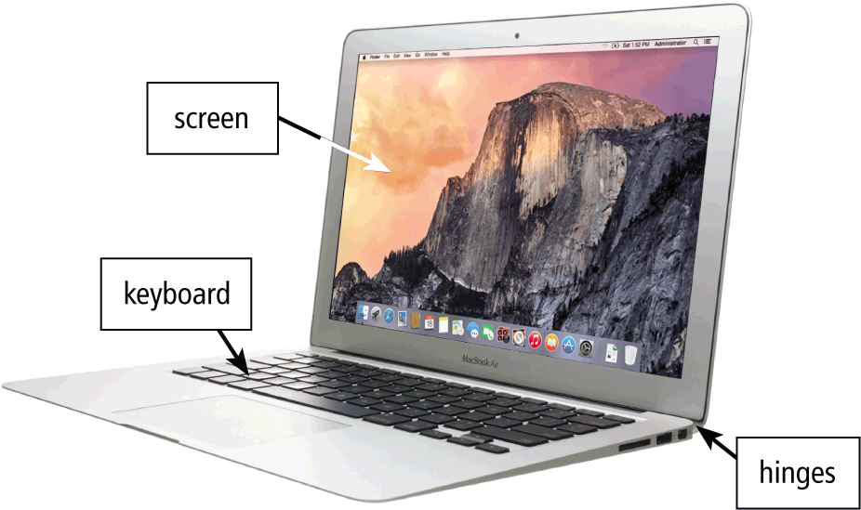
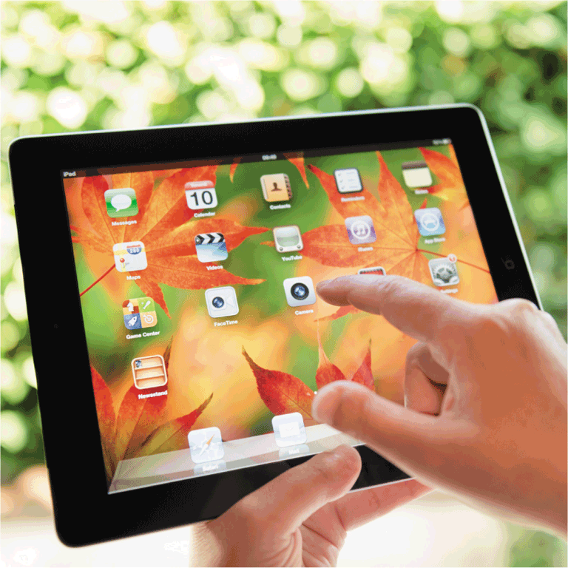
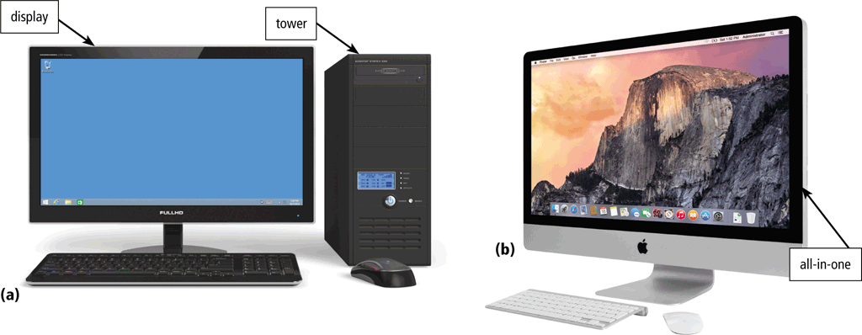
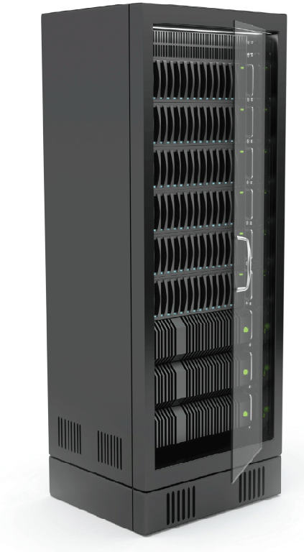
Computers
Laptop
Tablet
Desktop and All-in-One
Server
Pages 4 and 6
Figures 1-2 – 1-5

Slide 8
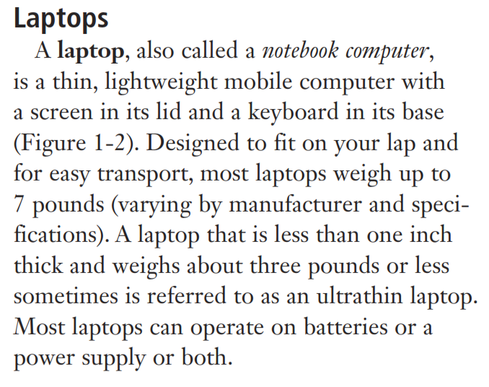
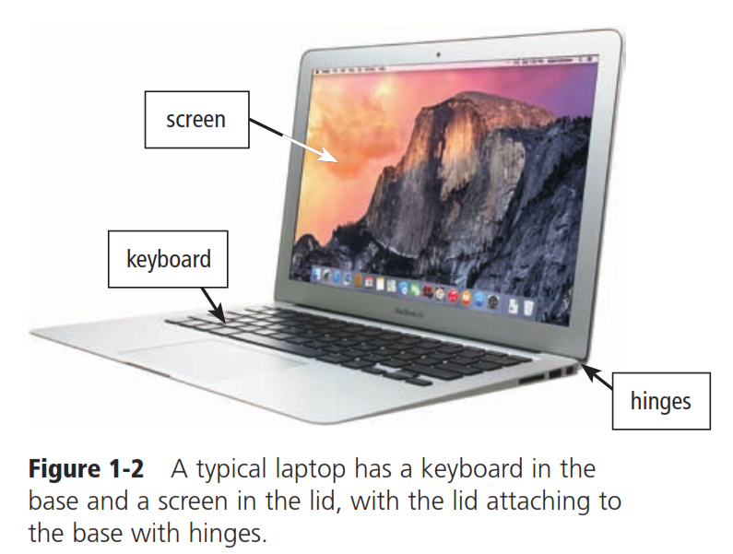
Laptop

Slide 9
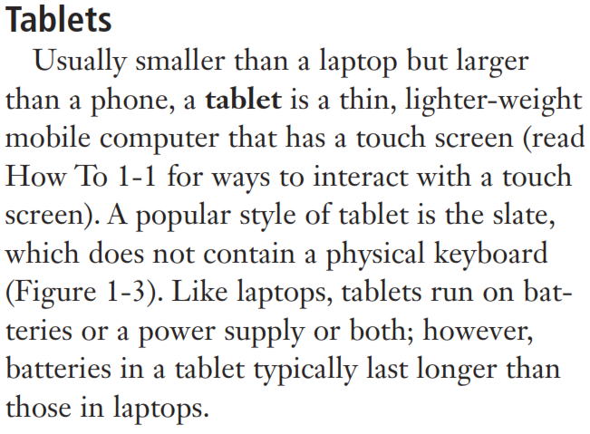
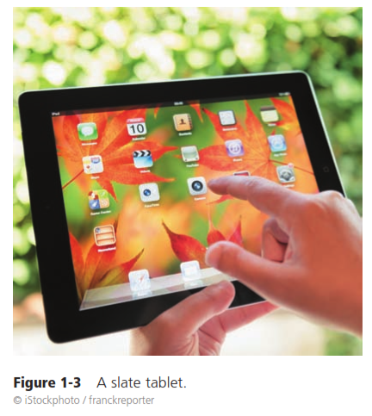
Tablet

Slide 10
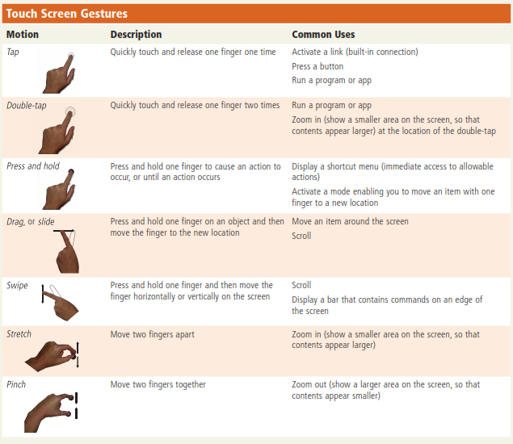

Slide 11
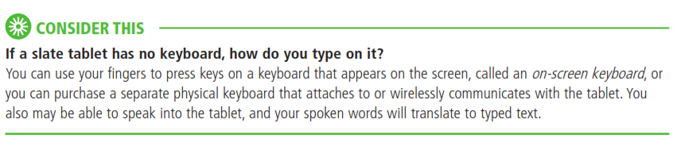

Slide 12
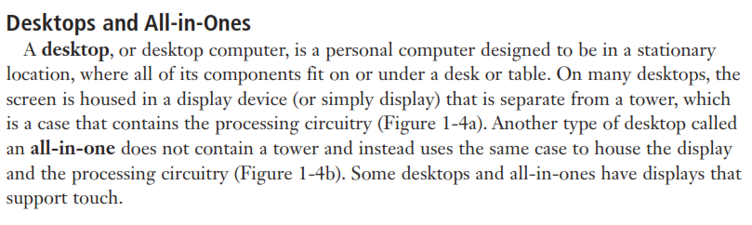
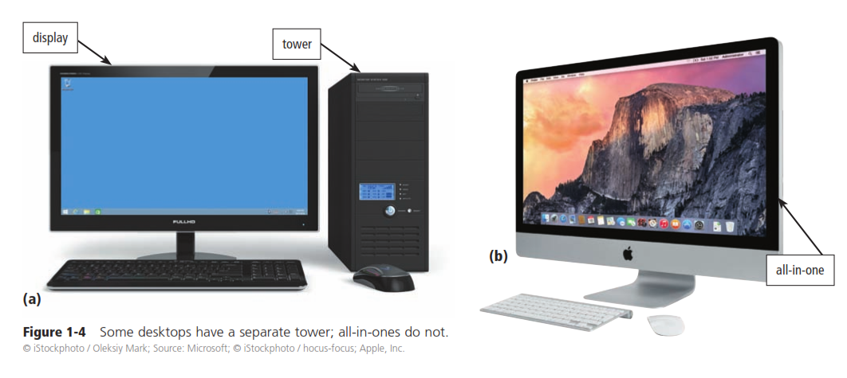

Slide 13
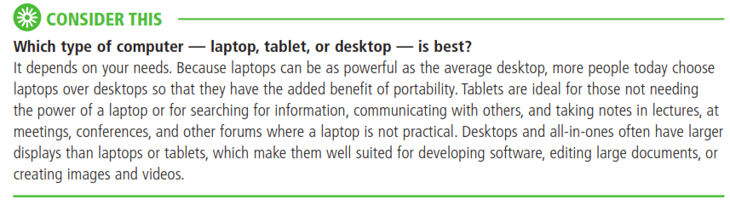

Slide 14
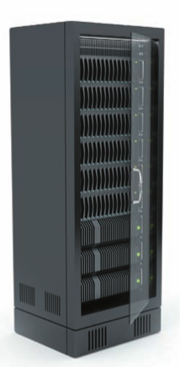
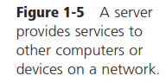
Computers For Organizations
Network servers
Centralized computer
All other computers connect
Provides access to network resources
Multiple servers are called server farms
Often simply a powerful desktop

Slide 15
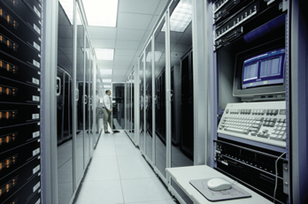
Computers For Organizations
Mainframes
Used in large organizations
Handle thousands of users
Users access through a terminal

Slide 16
Computers For Organizations
Minicomputers
Called midrange computers
Power between mainframe and desktop
Handle hundreds of users
Used in smaller organizations
Users access through a terminal

Slide 17
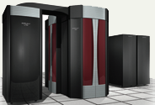
Computers For Organizations
Supercomputers
The most powerful computers made
Handle large and complex calculations
Process trillions of operations per second
Found in research organizations

Slide 18
Mobile and Game Devices
Smartphone
Digital camera
Portable and digital media player
E-book reader
Game device
Wearable device
Pages 7 - 10
Figures 1-6 – 1-11

Slide 19
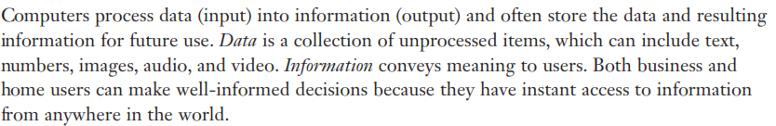
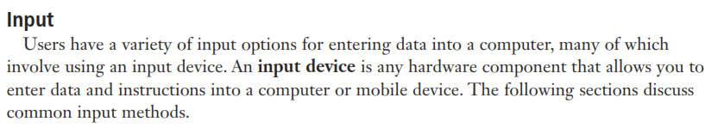
Data and Information

Slide 20
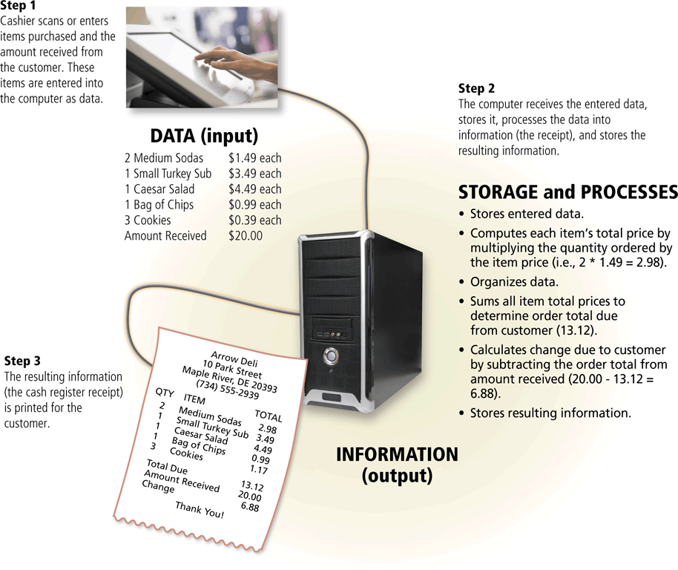
Data and Information
Can you give any other example ?
Page 12
Figure 1-12

Slide 21
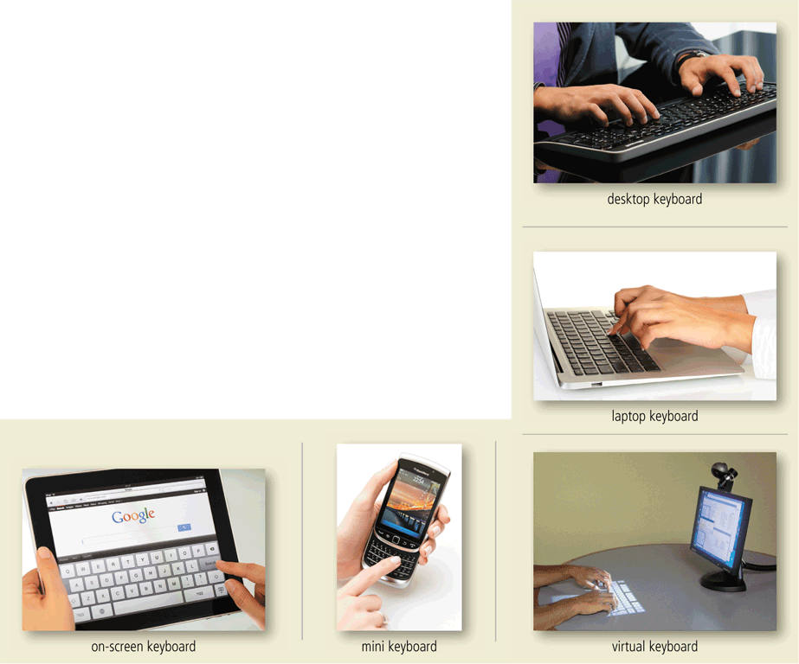
Data and Information
A keyboard contains keys you press to enter data and instructions into a computer or mobile device
Page 13
Figure 1-13

Slide 22
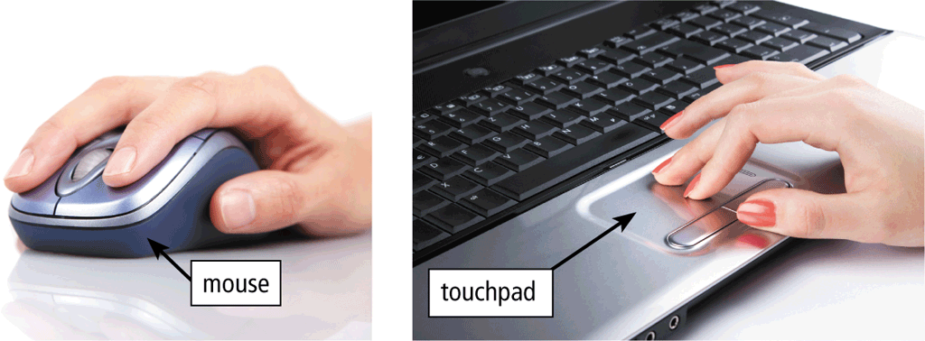
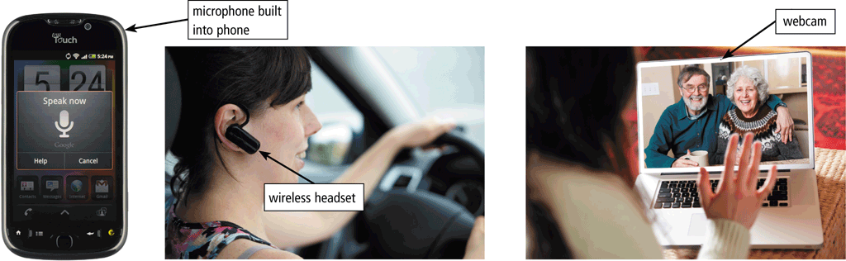
Data and Information
A pointing device is an input device that allows a user to control a small symbol on the screen called the pointer
Some mobile devices and computers enable you to speak data instructions using voice input and to capture live full-motion images using video input
Pages 13 – 14
Figures 1-14 – 1-15

Slide 23
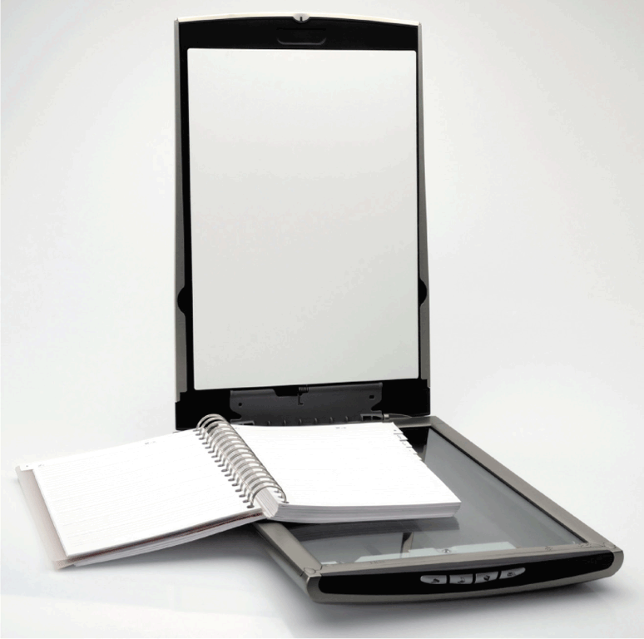
Data and Information
A scanner is a light-sensing input device that converts printed text and images into a form the computer can process
Page 14
Figure 1-16

Slide 24
Data and Information
An output device is any hardware component that conveys information from a computer or mobile device to one or more people
A printer is an output device that produces text and graphics on a physical medium, such as paper or other material
A 3-D printer can print solid objects, such as clothing, prosthetics, eyewear, implants, toys, parts, prototypes, and more
Pages 14 - 15

Slide 25
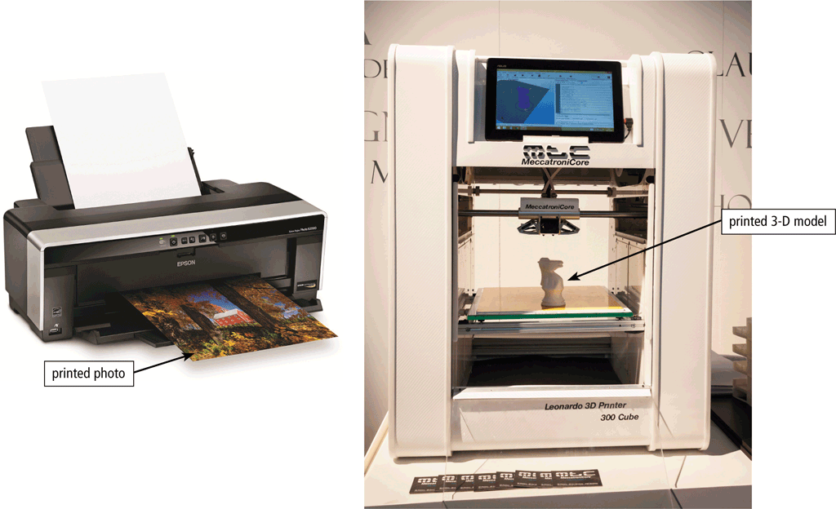
Data and Information
Page 15
Figure 1-17

Slide 26
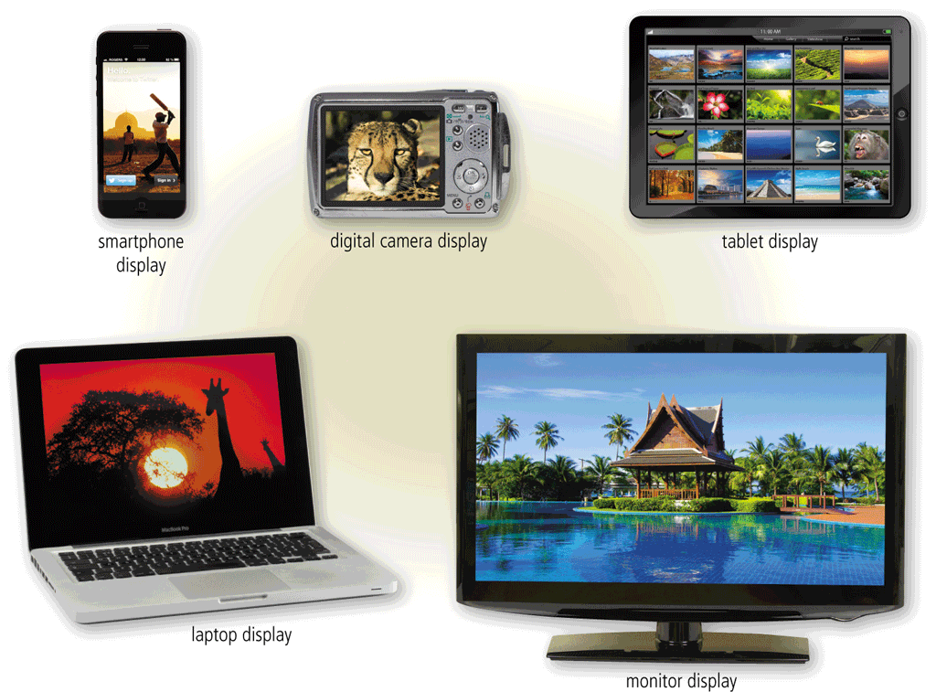
Data and Information
A display is an output device that visually conveys text, graphics, and video information
Page 15
Figure 1-18

Slide 27
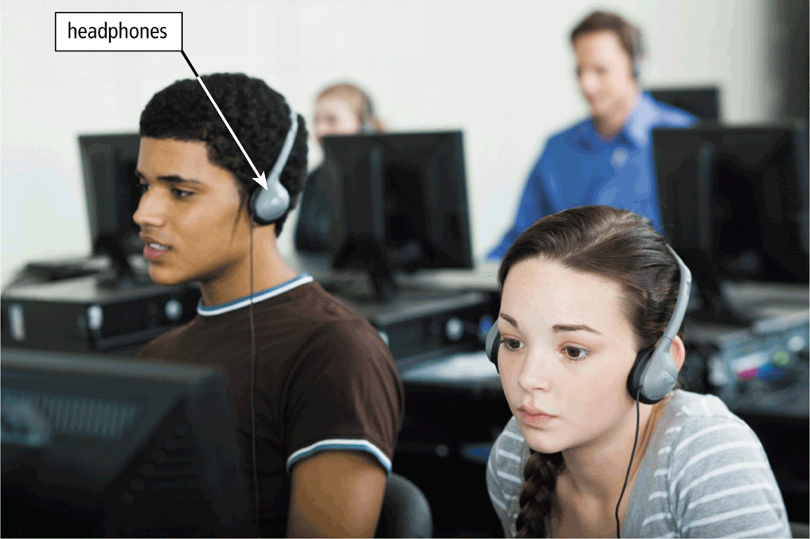
Data and Information
Speakers allow you to hear audio such as music, voice, and other sounds
Earbuds
Headphones
Page 16
Figure 1-19

Slide 28
Data and Information
Memory consists of electronic components that store instructions waiting to be executed and the data needed by those instructions
A computer keeps data, instructions, and information on storage media
A storage device records (writes) and/or retrieves (reads) items to and from storage media
Pages 16 - 17

Slide 29
Data and Information
Hard Disk
Solid-State Drive
USB Flash Drive
Memory Card
Optical Disc
Cloud Storage
Pages 17 – 19
Figures 1-20 – 1-26

Slide 30
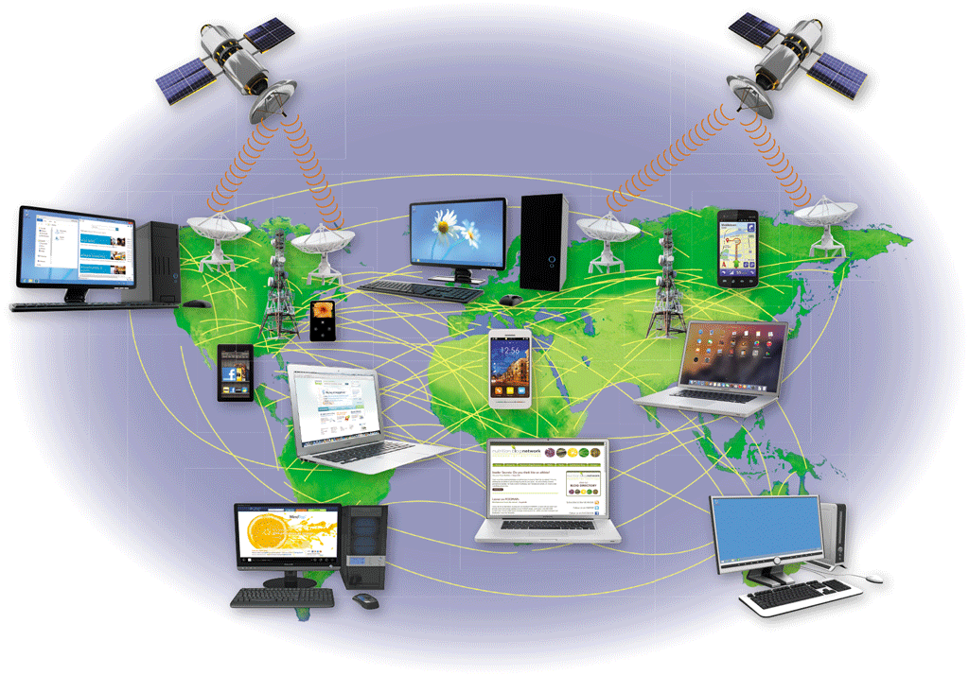
The Web
The Internet is a worldwide collection of computer networks that connects millions of businesses, government agencies, educational institutions, and individuals
Page 20
Figure 1-27

Slide 31
The Web
The World Wide Web (or web, for short) is a global library of information available to anyone connected to the Internet
The web consists of a worldwide collection of electronic documents, each of which is called a webpage
A website is a collection of related webpages
A web server is a computer that delivers requested webpages to your computer
Pages 20 – 21

Slide 32
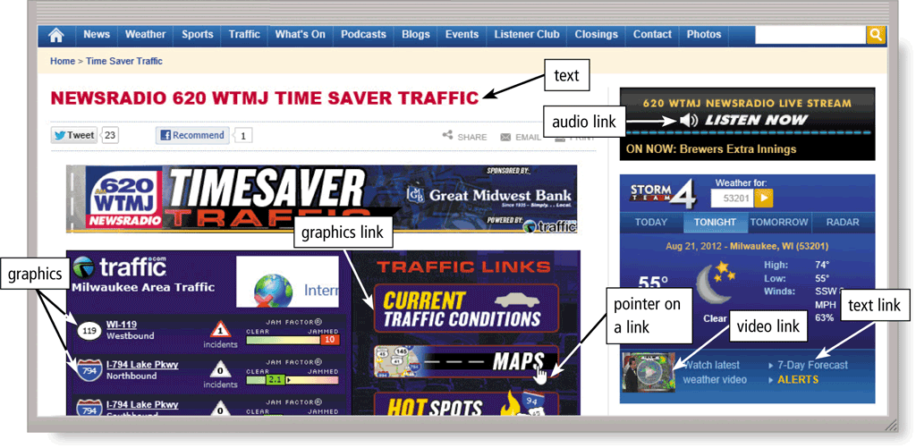
The Web
Page 19
Figure 1-26

Slide 33
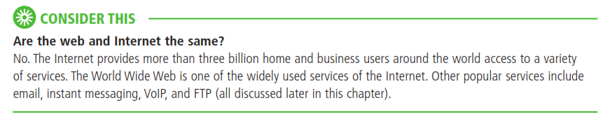

Slide 34
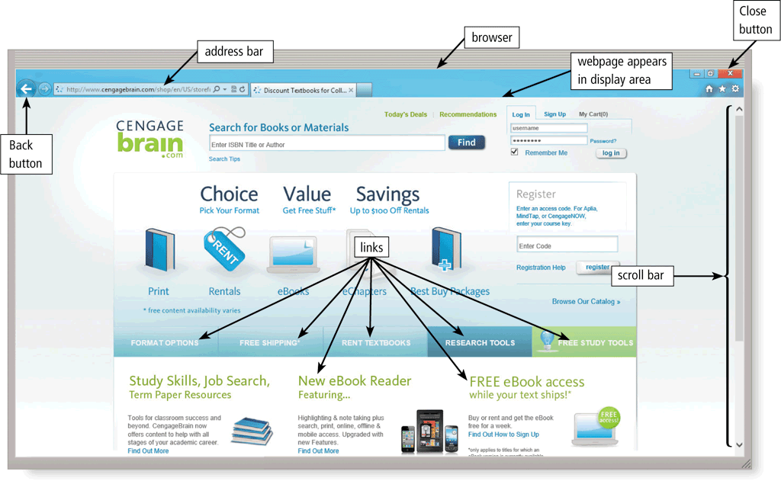
The Web
A browser is software that enables users with an Internet connection to access and view webpages on a computer or mobile device
Page 21

Slide 35
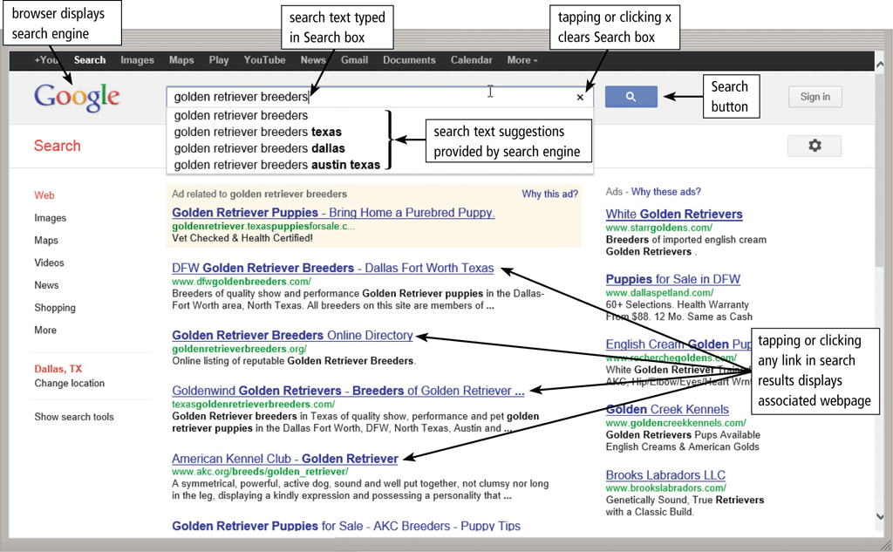
The Web
A search engine is software that finds websites, webpages, images, videos, news, maps, and other information related to a specific topic
Page 22

Slide 36
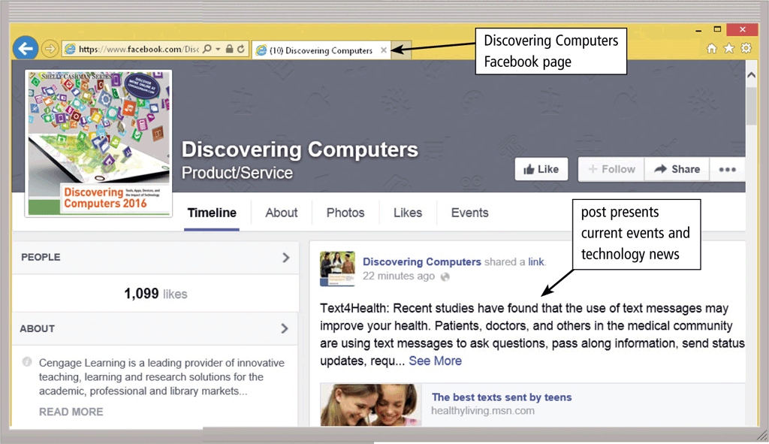
The Web
An online social network encourages members to share their interests, ideas, stories, photos, music, and videos with other registered users
Page 23
Figure 1-29

Slide 37
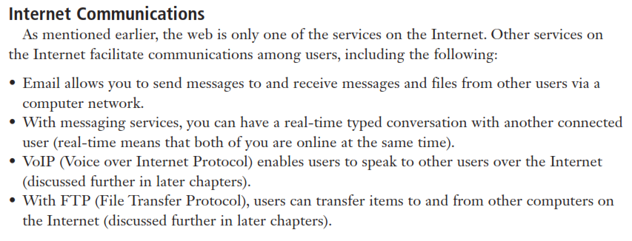
Internet Communications

Slide 38
Digital Safety and Security
It is important that users protect their computers and mobile devices
Viruses and Other Malware
Privacy
Health Concerns
Environmental Issues
Pages 24 - 26

Slide 39
Digital Safety and Security
Green computing involves reducing the electricity consumed and environmental waste generated when using a computer
Strategies include:
Recycling
Using energy efficient hardware and energy saving features
Regulating manufacturing processes
Extending the life of computers
Immediately donating or properly disposing of replaced computers
Page 26

Slide 40
Programs and Apps
Software, also called a program, tells the computer what tasks to perform and how to perform them
System Software
Operating system
Tools
Applications
Pages 26 - 27
Figure 1-30

Slide 41
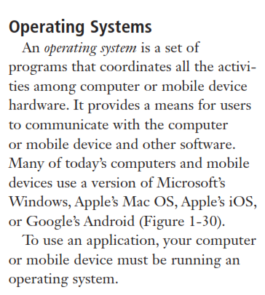
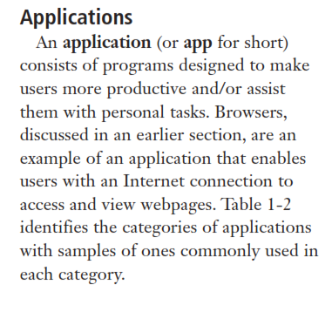
Programs and Apps

Slide 42
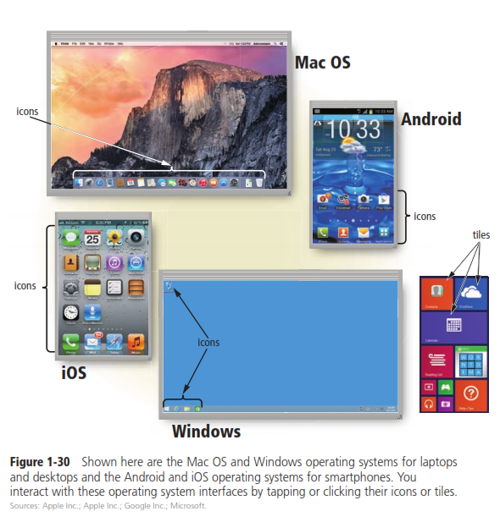

Slide 43
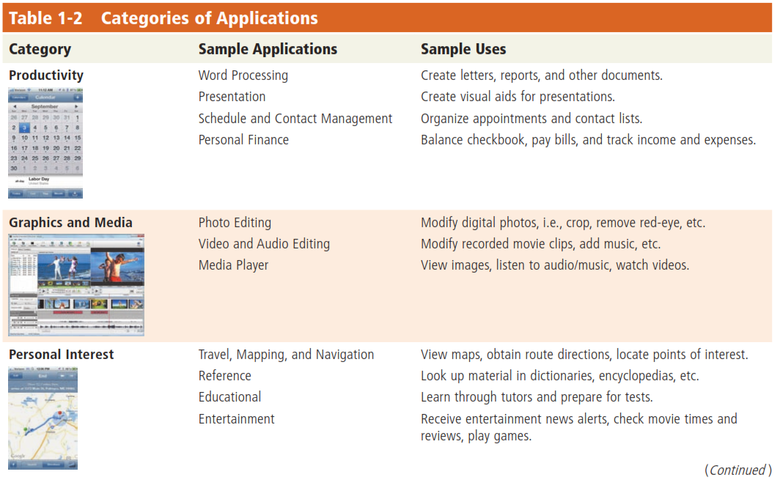
Page 27

Slide 44
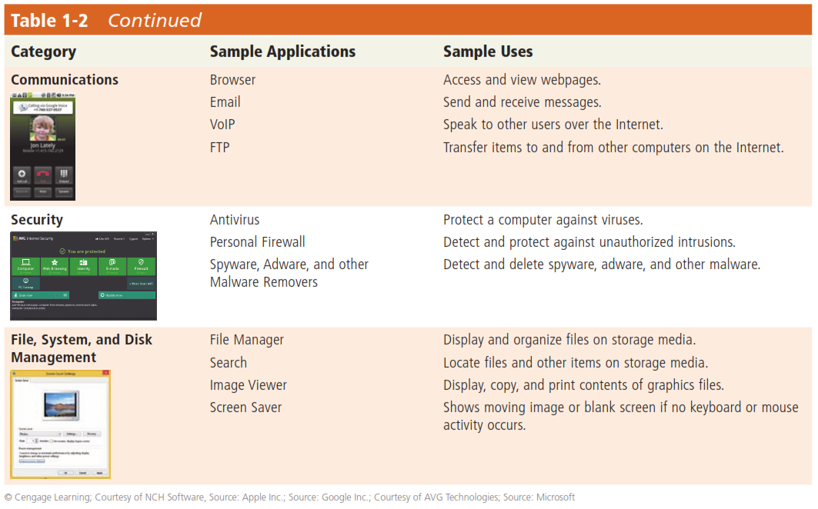
Page 28

Slide 45
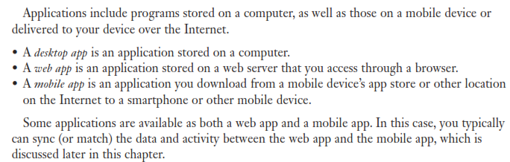
Applications
Page 28

Slide 46
Programs and Apps
Installing a program is the process of setting up the program to work with the computer, mobile device, printer, and/or other hardware
Once installed, you can run a program so that you can interact with it
You interact with a program through its user interface
Pages 28 - 29

Slide 47
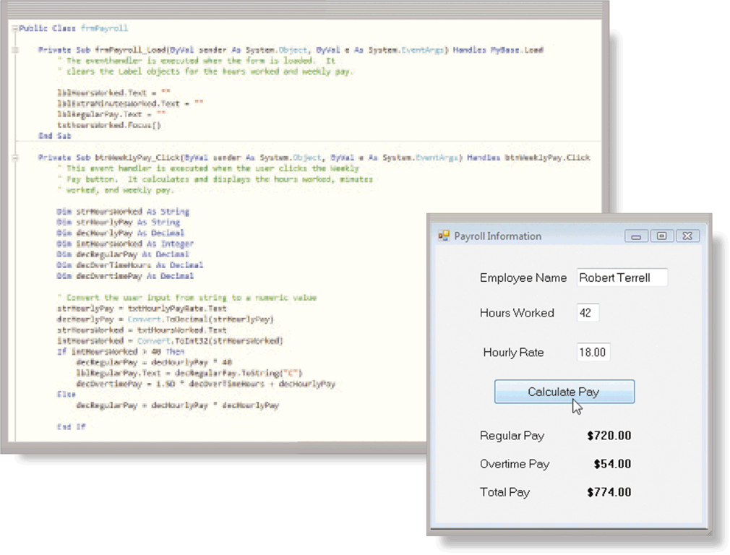
Programs and Apps
A software developer, sometimes called a developer or programmer, is someone who develops programs and apps or writes the instructions that direct the computer or mobile device to process data into information
Pages 29 - 30
Figure 1-31

Slide 48
Communications and Networks
In the course of a day, it is likely you use, or use information generated by, one or more of these communications technologies
Chat rooms
Email
Fax
FTP
GPS
Instant messaging
Internet
Newsgroups
RSS
Videoconference
Voice mail
VoIP
Wireless Internet access points
Wireless messaging services
Pages 30 - 31

Slide 49
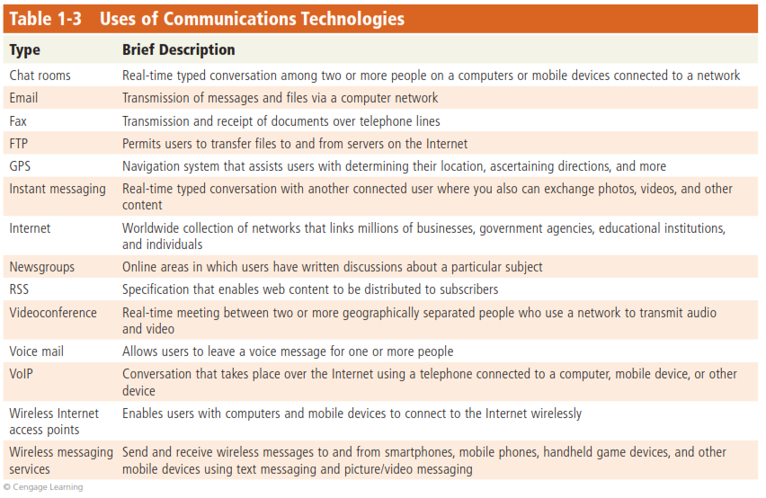

Slide 50
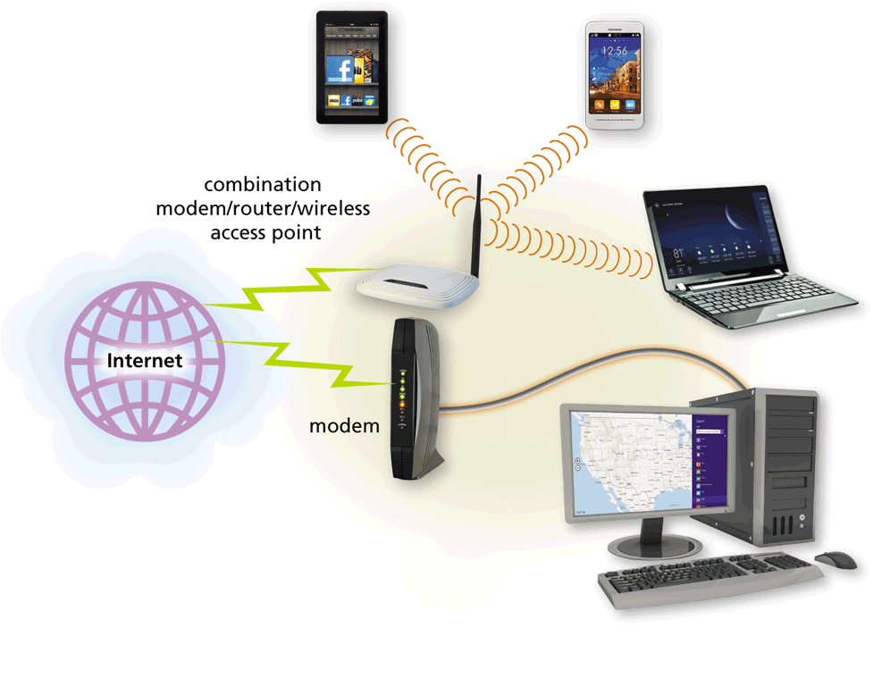
Communications and Networks
A communications device is hardware capable of transferring items from computers and devices to transmission media and vice versa
Page 31
Figure 1-32

Slide 51
Communications and Networks
Examples of wireless communications technologies include:
Wi-Fi
Bluetooth
Cellular radio
Pages 31 - 32

Slide 52
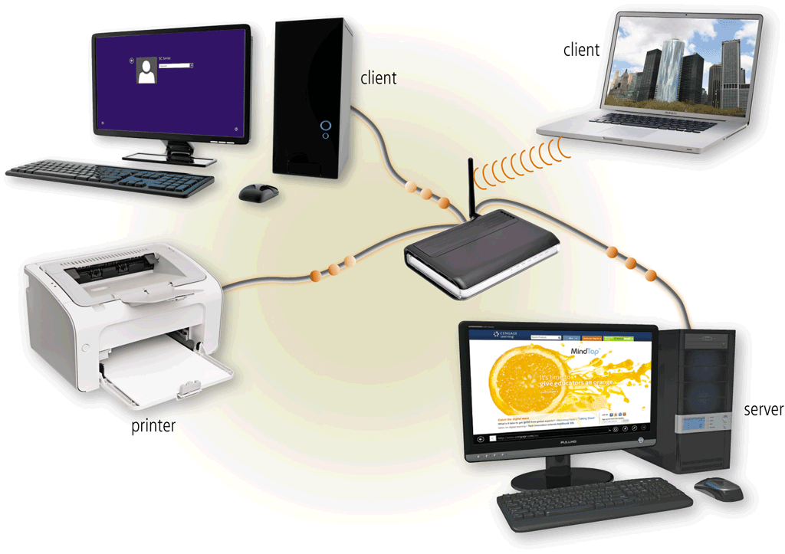
Communications and Networks
A network is a collection of computers and devices connected together, often wirelessly, via communications devices and transmission media
Page 32
Figure 1-33

Slide 53
Communications and Networks
Home Networks
Connect to the Internet
Access photos, music, videos, and other content
Share devices
Connect game consoles to the Internet
Subscribe to and use VoIP
Play multiplayer games
Share a single high-speed Internet connection
Interact with other devices in a smart home
Business Networks
Facilitate communications
Share hardware
Share data, information, and software
Page 33

Slide 54
Technology Uses
Education
Government
Finance
Retail
Entertainment
Health Care
Science
Travel
Publishing
Manufacturing
Pages 35 - 41

Slide 55
Technology Users
Home User
Small/Home Office User
Mobile User
Power User
Enterprise User
Pages 41 - 42

Slide 56
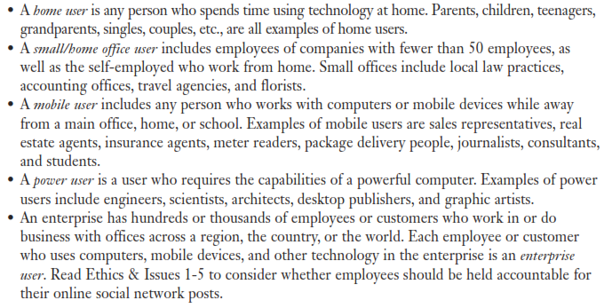
Technology Users

Slide 57
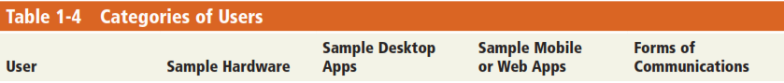
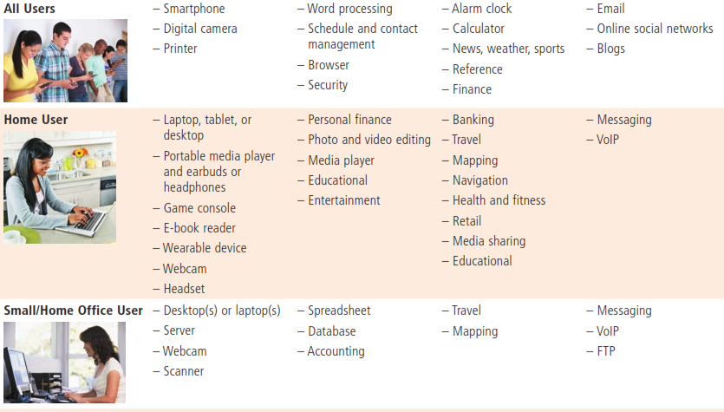

Slide 58
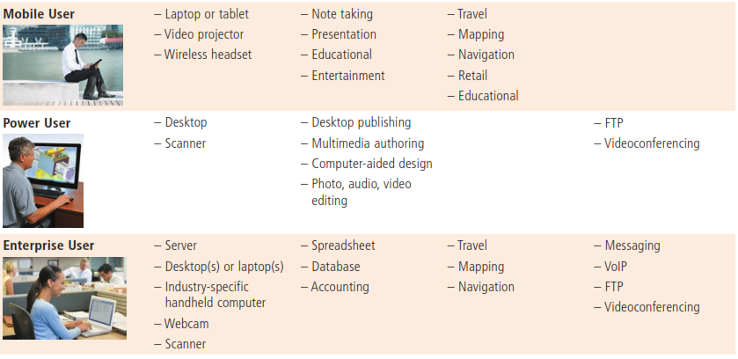

Slide 59
Chapter Summary
Basic computer concepts
Various methods for input, output, memory, and storage
The Internet
Digital security and safety risks and precautions
Uses of technology applications in society
Page 43

Slide 60
Chapter 1 Complete

Slide 61
Questions are guaranteed in Life….. Answers are not!
Questions

